Slide 1
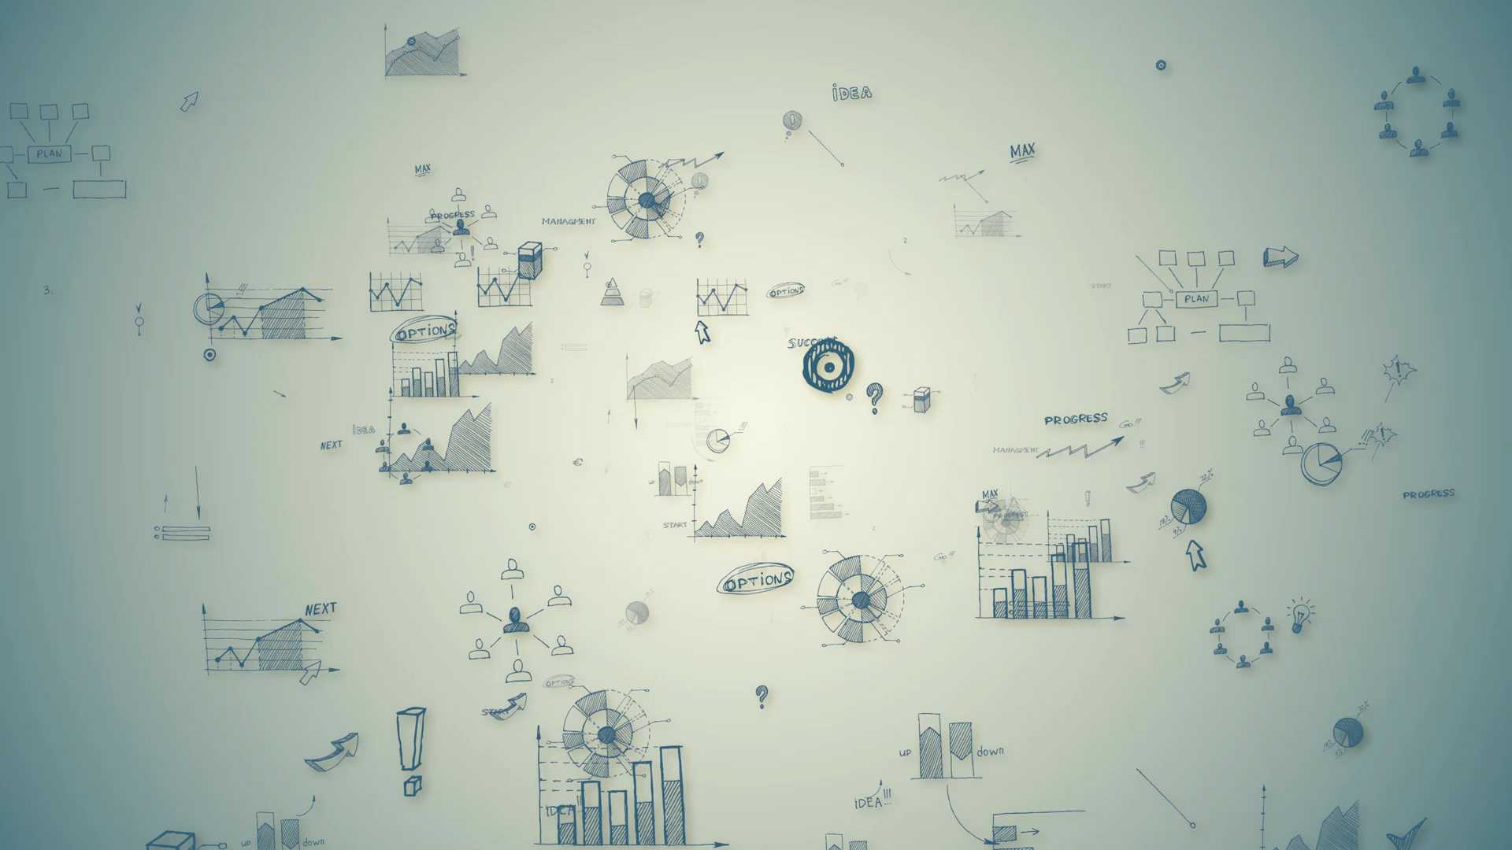
Customer Personality Analysis
A Path to Effective Marketing

Slide 2




Prasad Thamada
(Team Lead & Data Analyst)
Ankita Ramachandra Manjarekar
( Data Researcher & Engineer)
Swetha Kancharla
(Data Pipeline Developer)
Pallavi Bongu (ETL Developer)
Team - 02
https://github.com/dsci6007-team2/customer_personality_analysis

Slide 3
Problems
Problem #1
Problem #2
A company is investing a lot of money to market their new products to all their customers. Instead of marketing it to all the customers, They wanted to identify which customers are more likely to purchase the products and whom to advertise based on their historical data.
The company also wanted to understand its customers and modify the products according to their specific needs, behavior and concerns of different types of customers. Instead of investing a lot of money in making all products at large quantity, they wanted to reduce it.
01
02

Slide 4
Solutions
We will build Customer personality analysis model which helps a business modify its product based on its target customers from different types of customer segments. The company can analyze which customer segment is most likely to buy the product and then market the product only on that segment using the data analytical solution.
Customer Personality Analysis is a detailed analysis of a company’s ideal customers. It also helps a business to better understand its customers and makes it easier for them to modify products according to the specific needs, behaviors and concerns of different types of customers.
01
02

Slide 5
Data Analysis
"Analytics Maturity Model" or the "Analytics Continuum". It represents the progressive stages of data analysis in increasing order of complexity and value.
Description Analytics: Descriptive analytics involves summarizing historical data to provide insights into what has happened in the past. This often includes basic statistics, visualizations, and summary reports. Descriptive analytics answers questions like "What happened?" and "What is the current state of affairs?"
Diagnostic Analytics: Diagnostic analytics goes a step beyond descriptive analytics. It aims to understand why certain events or trends occurred in the past. This involves exploring relationships between variables, identifying patterns, and uncovering the root causes of specific outcomes. Diagnostic analytics answers questions like "Why did it happen?" and "What were the contributing factors?"
Predictive Analytics: Predictive analytics uses historical data and statistical algorithms to make informed predictions about future events or trends. It involves building models that can forecast or estimate outcomes based on patterns observed in the data. Predictive analytics answers questions like "What is likely to happen in the future?" and "What are the potential outcomes?"
Prescriptive Analytics: Prescriptive analytics is the highest level of data analysis. It not only predicts future outcomes but also provides recommendations or actions that should be taken to achieve a desired outcome. This involves using optimization and simulation techniques to determine the best course of action. Prescriptive analytics answers questions like "What should we do to achieve a specific goal?"
The project focuses on conducting a comprehensive analysis of a company's customer base to gain a deeper understanding of its characteristics, preferences, and behaviors. The aim is to use this information to tailor products and marketing strategies to specific customer segments by the analytics continuum model.

Slide 6
Analytics
Human Input
Data
Descriptive
What happened?
Diagnostic
Why did it happen?
Decision
Predictive
What will happen?
Action
Decision support
Prescriptive
What should I do?
Decision support
Decision Automation

Slide 7
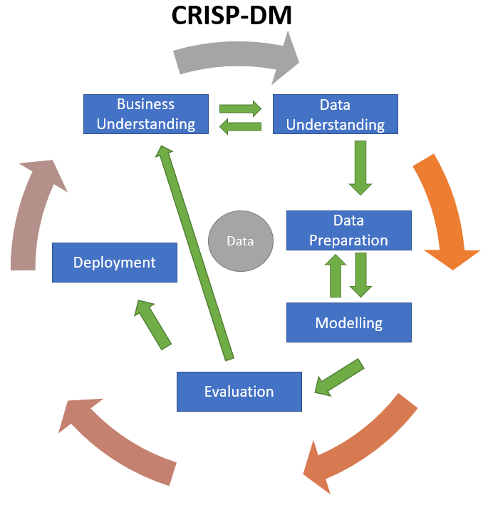
Business model: CRISP-DM Methodology
Business understanding – What does the business need?
2.Data understanding – What data do we have / need? Is it clean?
3.Data preparation – How do we organize the data for modeling?
4.Modeling – What modeling techniques should we apply?
5.Evaluation – Which model best meets the business objectives?
6.Deployment – How do stakeholders access the results?

Slide 8
Business Understanding
The goal is to identify the customer segments based on their interests and similarities. A company can analyze which customer segment is most likely to buy the product and then market the product only on that segment. It helps a business to better understand its customers and makes it easier for them to modify products according to the specific needs
Understand the core objectives of the business and their requirements

Slide 9
Data Understanding
Data Collection
Data Sources
Data Types
Data Volume
Data Quality
Data Preprocessing
Data Limitations
Understand the data you're working with, its structure, quality, and relevance to the problem at hand
Data sets:
Customers
Products
Promotion
Purchasing Place
Data source: https://www.kaggle.com/datasets/imakash3011/customer-personality-analysis/data

Slide 10
Attributes
Customers
ID: Customer's unique identifier
Year_Birth: Customer's birth year
Education: Customer's education level
Marital_Status: Customer's marital status
Income: Customer's yearly household income
Kidhome: Number of children in customer's household
Teenhome: Number of teenagers in customer's household
Dt_Customer: Date of customer's enrollment with the company
Recency: Number of days since customer's last purchase
Complain: 1 if the customer complained in the last 2 years, 0 otherwise
Promotion
NumDealsPurchases: Number of purchases made with a discount
AcceptedCmp1: 1 if accepted the offer in the 1st campaign, 0 otherwise
AcceptedCmp2: 1 if accepted the offer in the 2nd campaign, 0 otherwise
AcceptedCmp3: 1 if accepted the offer in the 3rd campaign, 0 otherwise
AcceptedCmp4: 1 if accepted the offer in the 4th campaign, 0 otherwise
AcceptedCmp5: 1 if accepted the offer in the 5th campaign, 0 otherwise
Response: 1 if accepted the offer in the last campaign, 0 otherwise
Products
MntWines: Amount spent on wine in last 2 years
MntFruits: Amount spent on fruits in last 2 years
MntMeatProducts: Amount spent on meat in last 2 years
MntFishProducts: Amount spent on fish in last 2 years
MntSweetProducts: Amount spent on sweets in last 2 years
MntGoldProds: Amount spent on gold in last 2 years
Place
NumWebPurchases: Number of purchases made through the company’s website
NumCatalogPurchases: Number of purchases made using a catalogue
NumStorePurchases: Number of purchases made directly in stores
NumWebVisitsMonth: Number of visits to company’s website in the last month

Slide 11

Data Collection and Integration
Data Cleaning
Data Transformation
Data Encoding
Feature Scaling
Data Splitting
Feature Selection
Data sampling
Data Saving
Data preparation

Slide 12
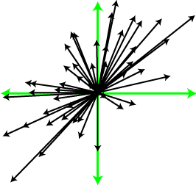

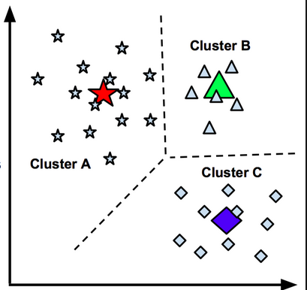
Modeling
Principal component analysis (PCA)
Dimensionality Reduction
Noise Reduction
Collinearity Mitigation
Feature Selection
Data Compression
Reduce Redundancy
Preprocessing for Clustering
Apply the K-means algorithm to the scaled dataset, specifying the chosen K value. The algorithm will cluster customers into K different groups based on their feature similarity. Use the cluster analysis results to segment customers into distinct groups. Each group may represent a different customer personality type.

Slide 13
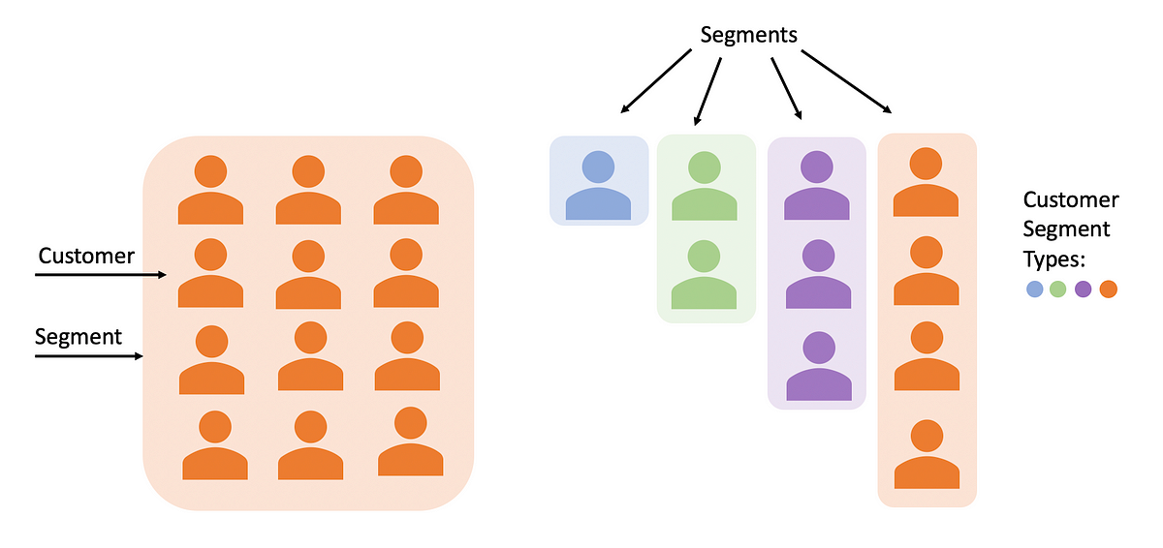
Result

Slide 14
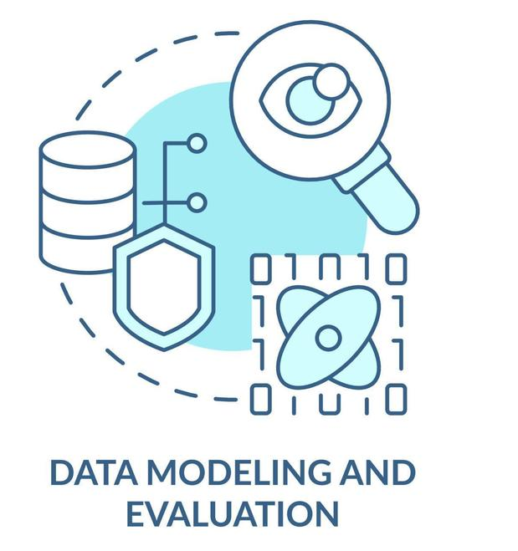
Evaluation
Evaluating PCA:
Variance Explained
Interpretability
Dimension Reduction Performance
Visualization
Evaluating K-Means Clustering:
Inertia (Within-Cluster Variance)
Silhouette Score
Davies-Bouldin Index
Cluster Size and Balance
Visual Inspection

Slide 15
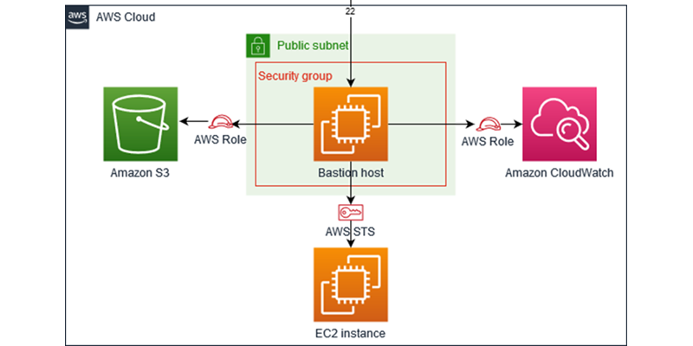
Deployment

Slide 16
Conclusion
In conclusion, our data science project on Customer Personality Analysis and Product Modification is going provided valuable insights and actionable recommendations for our client. Through rigorous data exploration, preprocessing, modeling, and clustering techniques, we are going to achieve the following
Identified distinct customer segments based on behavior, preferences, and characteristics.
Tailored product modifications and marketing strategies for each customer segment.
Implemented A/B testing to validate the effectiveness of our strategies.
Continuously monitored customer feedback and made iterative improvements.

Slide 17


